Slide 1



Explainable Vision-Language Diagnostic Assistant for Chest Radiographs
An offline, edge-optimized medical AI solution empowering rural health workers with automated chest X-ray interpretation, visual heatmap reasoning, and priority triage scoring.
PROJECT GROUP MEMBERS
P. Kavya Sai
P. Meghna
S. Anjana
D. Poojitha
2420030322
2420030401
2420030499
2420030697

Slide 2


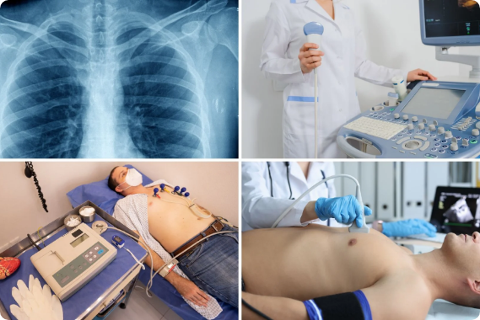
Problem Statement
Acute Radiologist Shortage: Primary health centers in rural regions lack specialist radiologists to read X-rays and detect conditions like pneumonia or tuberculosis.
Diagnostic Delays & Travel Burden: Patients travel vast distances to urban hospitals, delaying time-critical care and incurring heavy financial expense.
Black-Box AI Mistrust: Traditional AI systems provide class outputs without explanations, making local nurses reluctant to rely on machine predictions.
.

Slide 3






Project Objectives
1. Multimodal Diagnosis
2. Visual Explanation
Develop a vision-language assistant to generate plain-language diagnostic descriptions (e.g., "early signs of pneumonia") alongside class confidence scores.
Incorporate Grad-CAM heatmaps and attention overlays that circle the exact anatomical regions of concern, giving healthcare workers verifiable proof.
3. Automated Triage & Priority Guidance
Compute case urgency flags (e.g., "Please refer to specialist within 24 hours") so rural health workers can prioritize critical emergency cases immediately.

Slide 4


Literature Survey & Research Gap
Literature Survey (Existing Work)
Identified Research Gaps
Standard CNN Classifiers: ResNet & DenseNet models achieve strong classification accuracy on ChestX-ray14 but lack report generation capabilities.
Absence of Explainable Multimodal Grounding: Existing systems rarely combine textual diagnostics with exact visual heatmap verification.
Large Vision-Language Models: Heavy Transformer architectures generate clinical reports but require GPU servers and stable cloud APIs.
High Computational Overhead: Complete absence of quantized, offline-capable vision-language models for edge smartphone hardware.
Standalone Saliency Maps: Heatmap tools highlight regions but fail to explain clinical severity or provide actionable triage advice.
Lack of Actionable Triage Systems: Standard models output probabilities without translating them into emergency referral timelines for health workers.

Slide 5


Innovation, Creativity & Novelty
Dual-Stream VLM Core
Transparent Reasoning
Offline Edge Deployment
Combines Vision Transformers (ViT) for spatial feature extraction, CLIP for vision-text alignment, and BLIP-2 for diagnostic report synthesis into a unified framework.
Generates dual Grad-CAM heatmaps and cross-attention overlays on the X-ray scan, bridging the trust gap between automated AI outputs and rural clinical workers.
Pioneers 8-bit quantization on multimodal medical networks, enabling complete offline execution on mid-range Android mobile devices in zero-connectivity posts.

Slide 6

Datasets & Technical Methodology
Training Datasets
Pipeline Flow
Dataset | Resource URL | Key Details
ChestX-ray14 | NIH CC Box | 112,120 chest X-rays with 14 disease labels.
OpenI (OpenAccess) | NLM OpenI | 7,470 X-rays paired with clinical radiology reports.
ROCO Medical | GitHub / ROCO | Multimodal radiology dataset for text-image alignment.
Multi-Source Preprocessing: Normalization & augmentations.
ViT + CLIP Alignment: Encodes spatial features into shared space.
Dual Heads: Disease Classifier + BLIP-2 Natural Text Generator.
Explainability Layer: Grad-CAM heatmaps & attention maps.
Android Runtime: Quantized model providing offline triage.

Slide 7



Project Plan & Evaluation Strategy
PHASE 1
PHASE 2
PHASE 3
PHASE 4
Data Prep & Alignment
Model & Explainability
Optimization & Mobile
Evaluation & Presentation
•
Dataset curation (NIH, OpenI, ROCO)
•
ViT encoder & BLIP-2 report integration
•
INT8 model quantization
•
Metrics: Accuracy, Precision, Recall, F1
•
Data preprocessing & normalization
•
ONNX / Android runtime integration
•
CLIP vision-text alignment tuning
•
Grad-CAM heatmap layer development
•
Offline mobile performance testing
•
Heatmap localization verification
•
Final presentation on 8th August 2026
•
Attention overlay generation

Slide 8
THANK YOU!
Our project aims to bridge the rural diagnostic gap by delivering an honest, explainable, and fully offline AI assistant — ensuring patients receive timely and safe care regardless of geographic limitations.

